Slide 1

Predictive Japan Earthquake Model
Capstone project : G6 – Epicenter Visionaries
Guided by - Prof: Lei Wang
Presented by:
Vijval Vemula
Priyanka Patil
Alex Hoang
Mohamed Shehaf Aakil Sharfudeen

Slide 2
Agenda:
Predictive Modeling Problem Definition
Input Data Overview
Predictive Models Overview
Model Evaluation
Introduction
Output Definition
Summary
Statistical Data Representation
Lesson Learned

Slide 3
Introduction
We aim to develop a precise and dependable predictive earthquake model for Japan, a region prone to seismic activity. This model serves to offer advance warnings, ultimately aiding public safety, infrastructure resilience, and disaster management.​
Through historical data collection, feature engineering, and machine learning, our goal is to predict earthquake likelihood and magnitude, followed by rigorous model assessment. ​
Our deliverables include a predictive model, visualizations, comprehensive documentation, and a presentation summarizing our findings and their implications.

Slide 4
Predictive Modeling Problem Definition
Objective: To predict the magnitude of earthquakes in Japan, aiming to understand and anticipate seismic activity.
Hypothesis: The magnitude of earthquakes in Japan is influenced by a combination of spatial and temporal factors, including geographical coordinates, depth of the earthquake, time of occurrence, and seismic energy released.
Input Data Features:
Time: Timestamp indicating when the earthquake occurred.
Geographical Coordinates: Latitude and longitude of the earthquake epicenter.
Depth: Depth of the earthquake epicenter below the Earth's surface.
Magnitude: Measure of the earthquake's strength.
Seismic Energy: Indicator of the energy released during the earthquake.
Additional Features: Various seismic and geographical attributes such as type, distance to key cities, and seismic network details.

Slide 5
Continue
Feature Selection for Modeling:
Geographical Coordinates: Latitude and Longitude.
Temporal Factors: Time of Occurrence (preprocessed into timestamp).
Depth of the Earthquake.
Seismic Energy Released.
Importance of Features:
These features are crucial for understanding the complex dynamics of seismic events.
They serve as essential inputs for building predictive models to estimate earthquake magnitude accurately.

Slide 6
Input Data Overview
Tabular Format:
Data organized in rows and columns for structured analysis.
Data Dictionary:
Numerical Columns: Latitude, Longitude, Depth, Magnitude, etc.
Non-numerical Columns: Time, Magtype, Net, Place, etc.
Summary Statistics:
Overview of data types, count, and size.
Descriptive statistics for numerical columns.
Analysis of categorical columns.

Slide 7
Output Definition
Predictive Focus of Target Variable
Estimating earthquake magnitudes in Japan.
Essential for understanding seismic activity dynamics.
Significance of Predicting Magnitude:
Enables proactive measures like early warning systems.
Guides urban planning and infrastructure resilience efforts.
Practical Applications:
Predicts earthquake severity and potential impact.
Informs disaster preparedness and response strategies.

Slide 8
Predictive Models Overview
2. Gradient Boosting: A powerful machine learning technique for regression and classification tasks.
Sets up a progression of basic models one by one to refine predictions by learning from previous mistakes.
Enhances the loss function by applying gradient descent and regularization methods.
Frequently utilized implementations feature XGBoost, LightGBM, and CatBoost, renowned for their performance.
3. Neural Networks: Computational models inspired by the human brain.
Consist of neurons that are interconnected and organized into layers.
Adapt weights and biases iteratively through training by employing optimization methods such as gradient descent.
Different varieties include feedforward, convolutional, and recurrent neural networks, tailored for various tasks.
1.Support Vector Machines: A set of supervised learning methods used for classification, regression and outlier detection.
SVM is a powerful model for classification and regression tasks.
It finds the best hyperplane to separate classes while maximizing margin.
SVM is effective in high-dimensional spaces and widely applicable in various fields.

Slide 9
Support Vector Machines (SVM)
Initialize
Initialize the SVM model.
Define
Define the model, with kernels as linear and RBF
Fit
Fit the model on the training data with both the kernels seperately.
Predict
Predict the target variable on the test data.
Evaluate
Evaluate the model performance using Root Mean Squared error (RMSE) on the test set

Slide 10
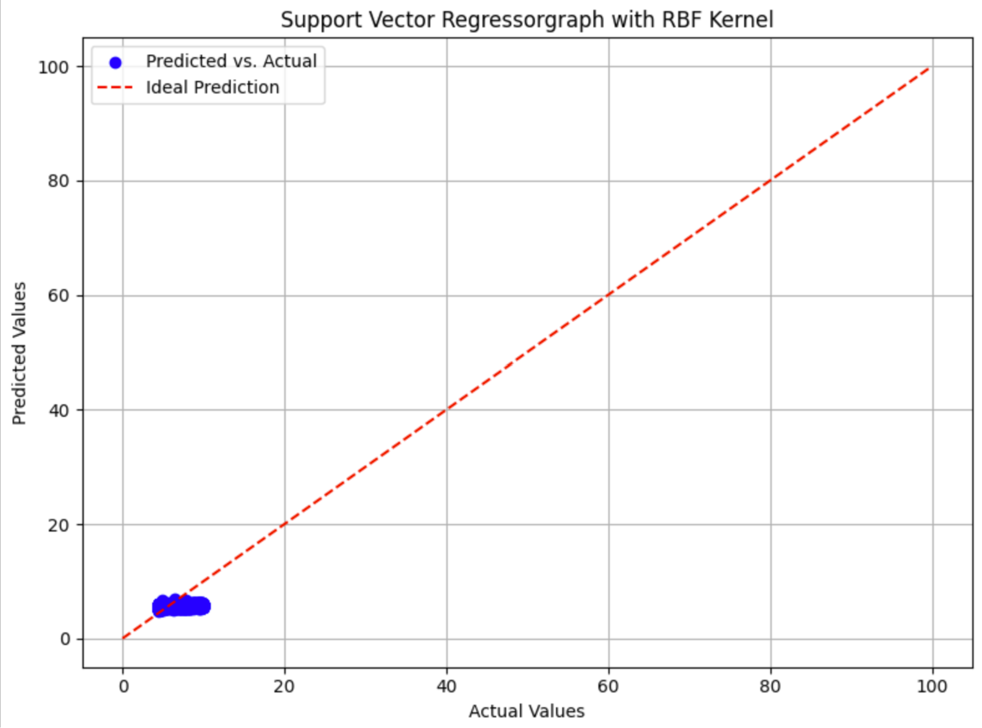
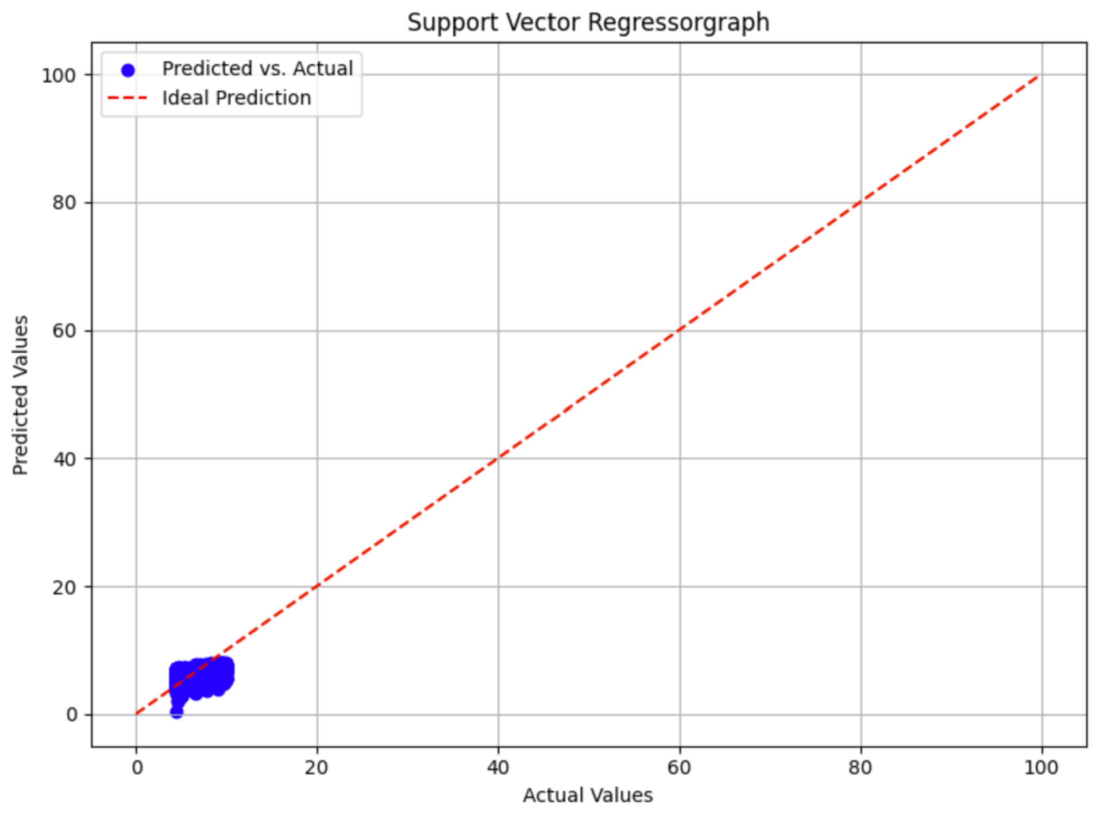
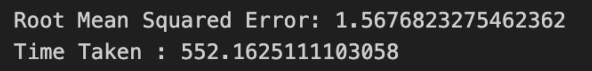
Continue

Slide 11
Continue
Strengths:
Reasons for Model Selection:
SVMs exhibit strong predictive accuracy, making them a popular choice for classification and regression tasks where high performance is crucial.
They are robust against overfitting, especially when using appropriate regularization techniques, ensuring stable performance across different datasets.
SVMs use only a subset of training points (support vectors) to define the decision boundary, making them memory efficient, particularly for large datasets.
Can handle both linear and nonlinear classification and regression tasks through the use of different kernel functions, making them suitable for a wide range of real-world problems.
SVMs naturally handle high-dimensional data and complex relationships between features, allowing them to effectively capture patterns and make accurate predictions in real-world scenarios.
SVMs have been successfully applied to various domains, including image classification, text categorization, and bioinformatics, demonstrating their versatility and effectiveness in solving diverse machine learning problems

Slide 12
Continue
Limitation:
Incorrect Choice of Kernel.
Model Complexity.
Non-linear Relationships

Slide 13
Gradient Boosting Regression (GBR)
Initialize
Initialize the Gradient Boosting Regressor model.
Define
Define a parameter grid for hyperparameter tuning including:
Number of estimators (trees) in the ensemble: [50, 100, 150]
Maximum depth of the trees: [3, 5, 7]
Perform
Perform grid search cross-validation to find the best combination of hyperparameters.
Fit
Fit the model on the training data using the best hyperparameters.
Predict
Predict the target variable on the test data.
Evaluate
Evaluate the model performance using root mean squared error (RMSE) on the test set
Learning rate: [0.01, 0.1, 0.2]

Slide 14
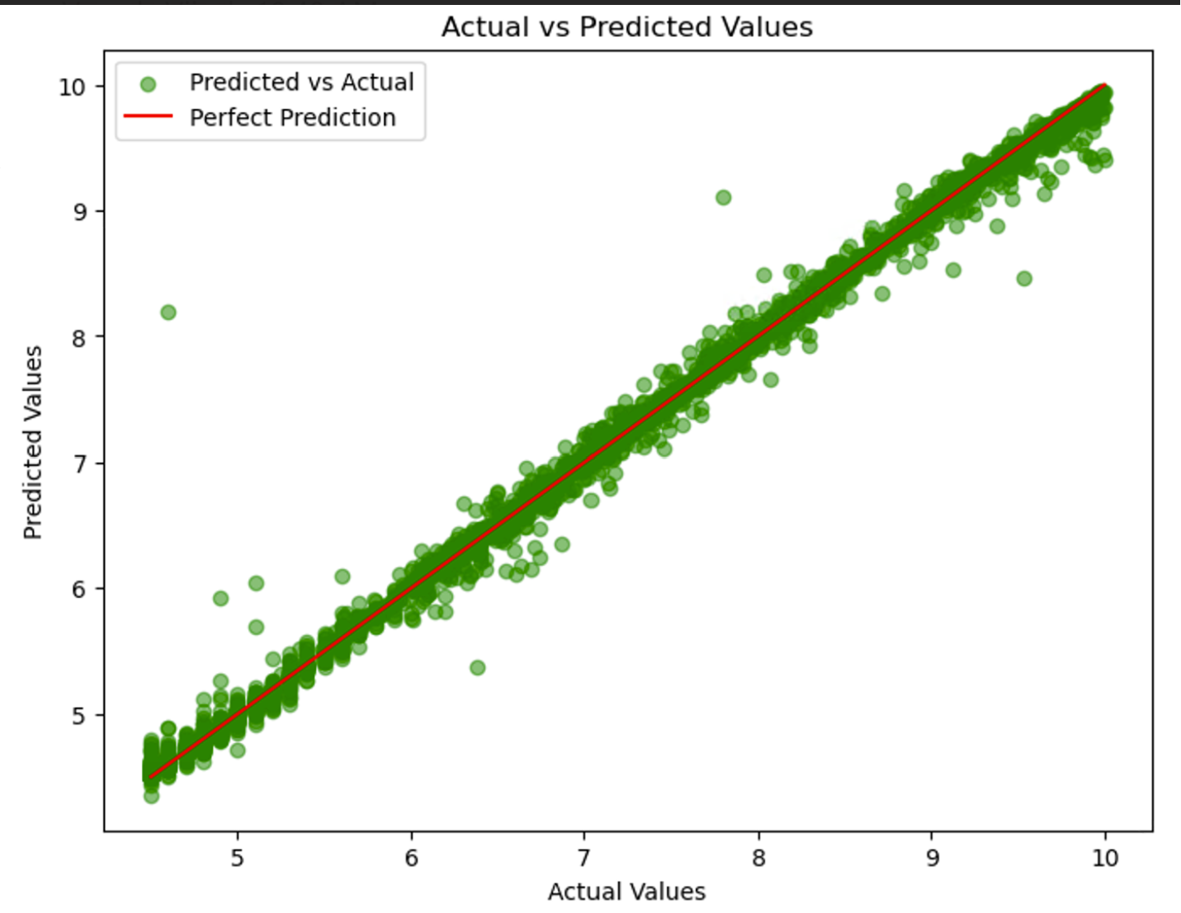
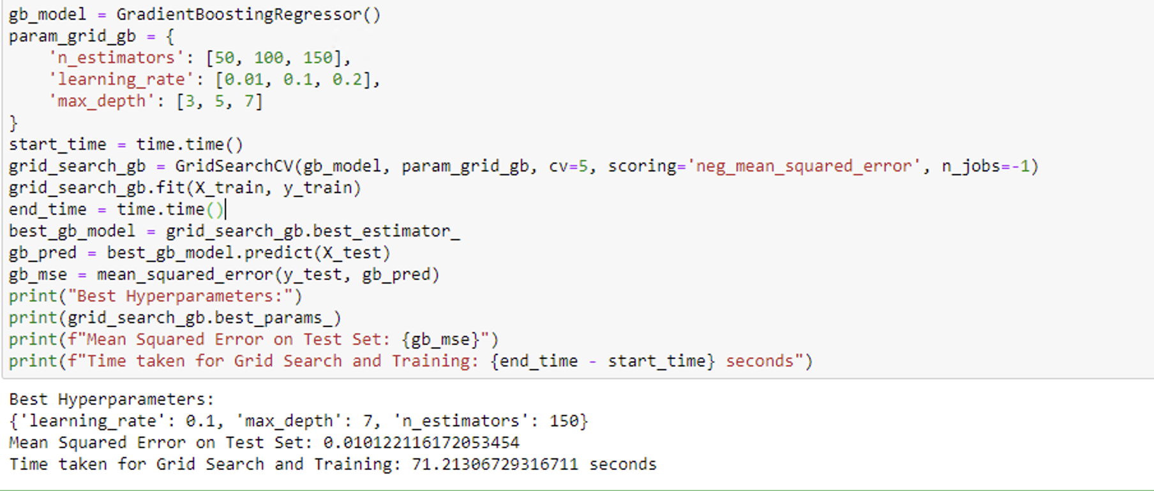
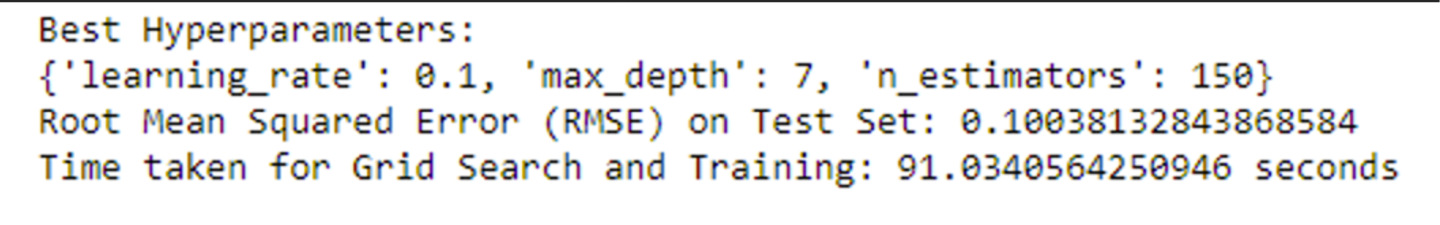
Continue

Slide 15
Continue
Strengths:
Reasons for Model Selection:
GBR is a popular choice for regression tasks due to its high predictive accuracy and robustness against overfitting.
Grid search is used to tune hyperparameters, ensuring optimal performance for the given data.
GBR is an ensemble method that builds trees sequentially, where each tree corrects the errors of the previous one, leading to strong predictive performance.
It handles well both numerical and categorical data without requiring data preprocessing.
GBR naturally handles interactions and non-linear relationships between features.
It automatically handles feature selection and can work with missing data.

Slide 16
Neural Networks
Initialize
Initialize a Sequential model in TensorFlow.
Add
Add multiple dense layers with ReLU activation:
Input layer with 200 neurons.
Hidden layers with 200, 150, 100, 50 and 25 neurons respectively.
Output layer with 1 neuron and linear activation.
Compile
Compile the model using mean squared error as loss function and Adam optimizer with learning rate 0.001.
Train
Train the model on the training data for 300 epochs with a batch size of 32.
Predict
Predict the target variable on the test data.
Evaluate
Evaluate the model performance using root mean squared error (RMSE) on the test set.

Slide 17
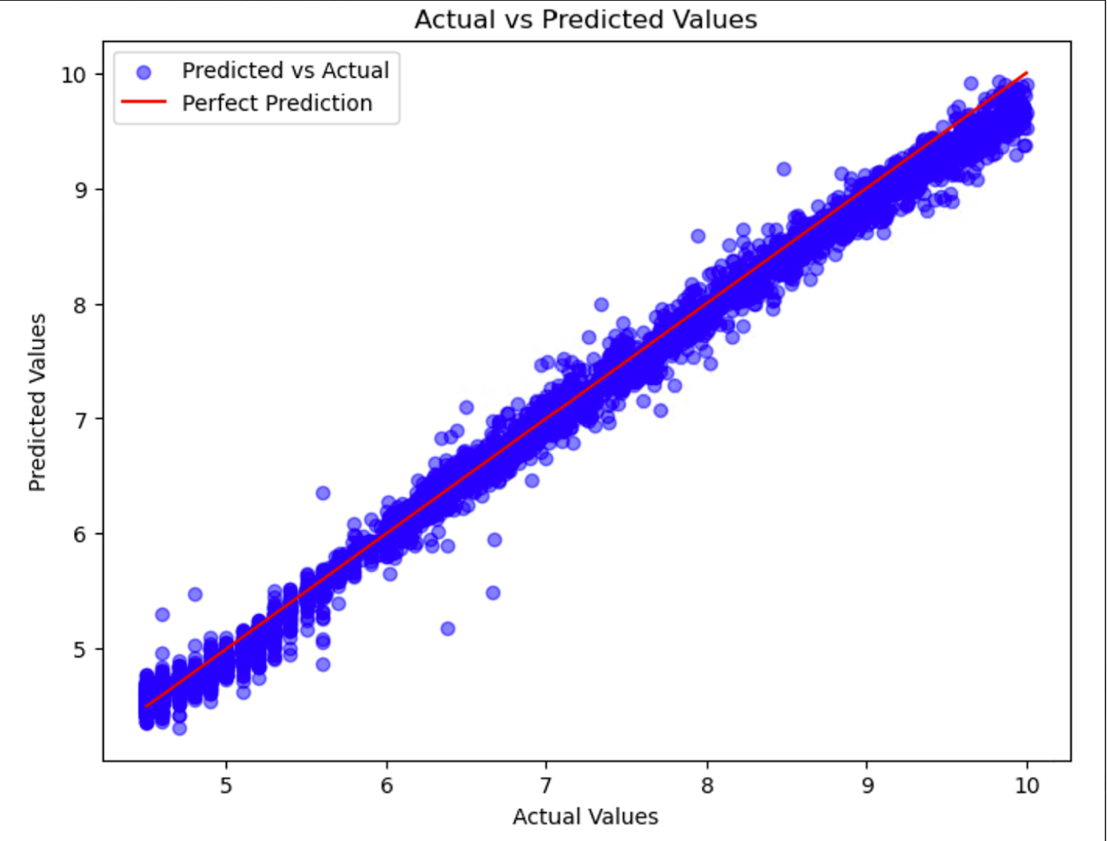
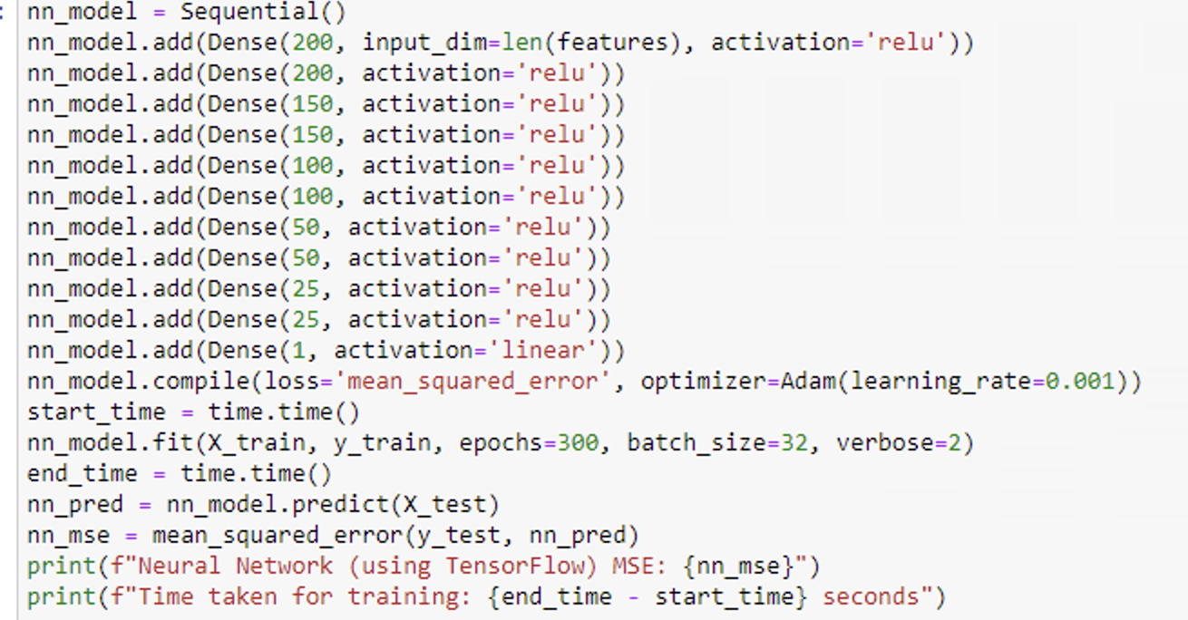
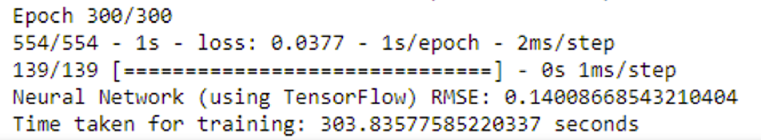
Continue

Slide 18
Continue
Strengths:
Neural networks are highly flexible models capable of learning complex patterns in data.
They can capture intricate relationships between features and the target variable through multiple hidden layers.
TensorFlow provides a powerful framework for building and training neural networks efficiently.
Reasons for Model Selection:
Neural networks are suitable for tasks where the relationships between features and the target variable are complex and non-linear.
In this case, the architecture of the neural network consists of multiple hidden layers, allowing it to learn intricate patterns in the seismic data.
The Adam optimizer with a learning rate of 0.001 is chosen for efficient convergence during training.

Slide 19
Model Evaluation
The choice of models is further justified by evaluating them using metrics such as root mean squared error (RMSE) on the test set.
Models are trained and evaluated on the same dataset, allowing for a fair comparison of their performance.
The models' performance is assessed based on how well they minimize the prediction error and generalize to unseen data.

Slide 20
Summary
The choice of Gradient Boosting Regressor, Neural Network, and SVM is justified by their ability to capture complex patterns in the data and their strong predictive performance, as evidenced by the evaluation metrics.
Moreover, the use of grid search for hyperparameter tuning ensures that the models are optimized for the given dataset.
We also wanted to experiment with the basics of neural networks, and that is why we deliberately included this as one of the models that we wanted to include as predictive models for this.

Slide 21
Lesson Learned
Feature Selection is Key
Careful selection of influential features improves model performance.
Data Preprocessing Matters
Proper cleaning and normalization enhance model effectiveness.
Evaluate and Interpret Results
Use metrics like RMSE for model assessment and feature importance analysis for insights.

Slide 22

Thank you

